Slide 1
Drug holidays and osteoanabolics
October 24, 2022
Leo Lai, MD FRCPC
Division of Geriatric Medicine
UBC Clinical Instructor

Slide 2
Disclosures
Honorarium for speaking from Amgen, consultancy fees from Paladin Labs

Slide 3
Objectives
When and why should a drug holiday from osteoporosis medications be offered? How long?
What can osteoanabolic agents (teriparatide, romosozumab) do for my patients? How do I prescribe them?

Slide 6
BC Coalition of Osteoporosis Physicians (http://bccop.org)
Physician resources
Referrals
Guidelines
Articles
Drug information, including zoledronate infusion referral forms
FLS resources
Patient resources
Education materials
Links to osteoporosis patient support groups

Slide 7
Would you give this patient a drug holiday?
70 year old female
Osteoporosis, no history of fractures
L1-4 T-score -3.1
Fem neck -2.9
Total hip -3.0
Type 2 diabetes, no other fracture risk factors
On alendronate for 5 years

Slide 8
Bisphosphonate drug holidays
Why do we do it?
Who should have a drug holiday?
What should the duration of the holiday be?

Slide 9
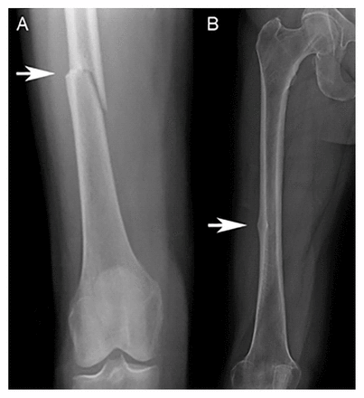
Drug holidays – why?
Atypical femoral fractures (AFF)
Notes:
AFF
Decreased bone remodelling, accumulation of microdamage, and stress fracture in femoral shaft
Prodromal thigh or groin pain in about 70% of patients
Subtrochanteric
Minimal comminution
Transverse or oblique
Medial spike
Often bilateral (two thirds of cases)
10 year alendronate, 6 years zol, and 7 years of risedronate have not demonstrated increase in AFF, but these studies are too small to detect rare event
Some larger population studies showed an increased risk with longer duration of use. 2-78 cases per 100,000 patient years for 2 to 8 years respectively

Slide 10
Source: https://fls.osteoporosis.ca/wp-content/uploads/Risk-communication-tool-final.pdf
Adapted from: Brown JP et al. Canadian Family Physician 2014
Notes:
Risk of Bis-AFF is 2-78 per 100,000 patient years for patients on therapy for 2 – 8 years
Risk of ONJ is less than risk of murder in Canada

Slide 11
Risk of AFF vs risk of osteoporotic fracture
“For every subtrochanteric fracture associated with bisphosphonate use, 100 hip fractures were prevented, in addition to prevention of other fractures”
McClung M, Harris ST, Miller PD, et al. 2013. American Journal of Medicine, The 126: 13-20.

Slide 12
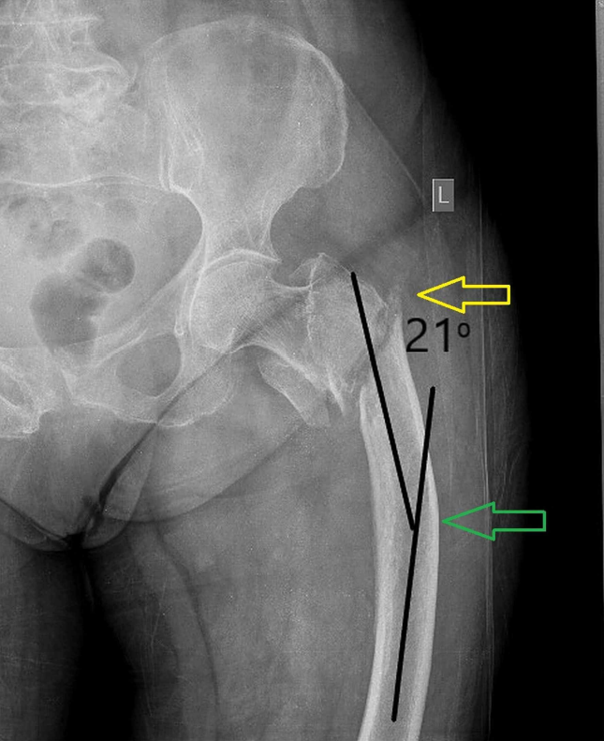
What are the risk factors for AFF
Duration of bisphosphonate
Asians
Female > male
Corticosteroids
?bowing of the femur
Osteoporos Int (2018) 29:1277–1283
Papaioannou I et al. Femoral Bowing and Femoral Neck-Shaft Angle Evaluation Can Reduce Atypical Femoral Fractures in Osteoporotic Patients: A Scientific Report. Cureus. 2020 Oct 2;12(10):e10771.
Notes:
Femoral bowing: the angulation between the proximal and distal quarters of the femoral diaphysis.

Slide 13
Black DM et al. Atypical Femur Fracture Risk versus Fragility Fracture Prevention with Bisphosphonates. N Engl J Med. 2020 Aug 20;383(8):743-753.

Slide 14
Black DM et al. Atypical Femur Fracture Risk versus Fragility Fracture Prevention with Bisphosphonates. N Engl J Med. 2020 Aug 20;383(8):743-753.

Slide 15
When should a holiday potentially be offered?
After 5 years of oral alendronate? (FLEX trial)
RR 0.45 clinical vert fractures in continuation group vs drug holiday group
Particularly higher rate of vert fractures if fem neck T-score < -2.5, or presence of prevalent vertebral fracture
After 3 years of IV bisphosphonate? (Z3P3 trial)
RR 0.51 Lower rate of radiographic vert fractures in zol group
Notes:
FLEX.
1099 postmenopausal women with 5 years of alendronate, randomized to continue or go on placebo for 5 more years.
- No increase in non-vertebral fractures
- Showed reduction in clinical vertebral fracture RR 0.45; 95% CI 0.25-0.85
HORIZON extension trial
- Showed reduction in radiographic vert fractures RR 0.51; 95% CI 0.26-0.95
Both studies had primary end points of studying bone density changes. There was only modest bone loss with discontinuation of therapy.
Risedronate observational studies show greater bone loss after only one year of discontinuation, so there is some suggestion that holidays should not be given on risedronate.

Slide 16
Who should be NOT be offered a holiday?
“Individuals at high risk for fracture should continue osteoporosis therapy without a drug holiday” (Canadian Osteoporosis Guidelines 2010)

Slide 17
When should treatment be restarted?
Rapid decrease in AFF risk with bisphosphonate discontinuation
70% reduction in risk of AFF after one year of drug holiday
Consider reevaluation of fracture risk after 2 years
Monitoring
BMD?
Serum bone turnover markers?
Brown JP, Morin S, Leslie W, et al. 2014. Canadian family physician 60: 324.

Slide 18
Guidelines – Endocrine Society 2019

Slide 19
Would you give this patient a drug holiday?
70 year old female
Osteoporosis, no history of fractures
L1-4 T-score -3.1
Fem neck -2.9
Total hip -3.0
Type 2 diabetes, no other fracture risk factors
On alendronate for 5 years
It depends. Is she Asian? Falls? Frailty? Improvements in BMD?

Slide 20
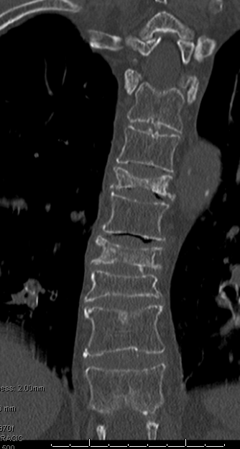
Holidays do not apply to other antiresorptives
Multiple vertebral fractures can occur after denosumab discontinuation
Cummings SR, Ferrari S, Eastell R, et al. 2018. Journal of Bone and Mineral Research 33: 190-198.
Notes:
Elevated risk of multiple vertebral fracture to nearly double of those who were on placebo
With as few as 2 doses of denosumab
Particularly in those with prior vert fractures

Slide 21
Rapid increase in bone turnover after discontinuing denosumab
Bone HG, Bolognese MA, Yuen CK, et al. 2011. The Journal of Clinical Endocrinology & Metabolism 96: 972-980.

Slide 22
Rapid decline in BMD after discontinuing denosumab

Slide 23
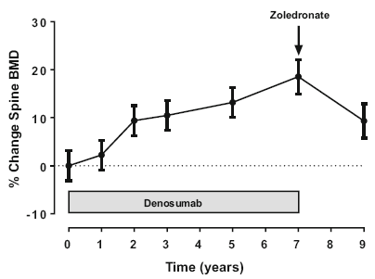
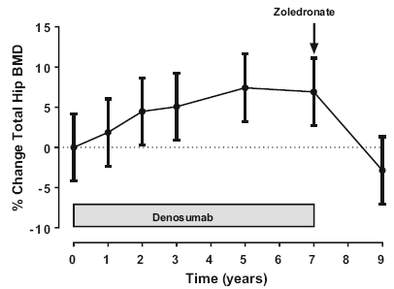
Discontinuing denosumab – must follow with another agent
Zoledronate after denosumab
Reid IR, Horne AM, Mihov B, Gamble GD. 2017. Calcified Tissue International 101: 371-374.
Notes:
Following denosumab treatment, bone turnover is substantially reduced so that BP uptake to bone surfaces may be low at that time.

Slide 24
Tsourdi E et al. Fracture risk and management of discontinuation of denosumab therapy: a systematic review and position statement by ECTS. J Clin Endocrinol Metab. 2020 Oct 26:dgaa756.

Slide 25
Frailty Osteoporosis
For every 0.10 increase in frailty index, HR of 1.18 for hip fractures and 1.30 for clinical vert fractures
Frailty index was comparable to FRAX for predicting fracture risk
Frailty as an outcome measure of fracture prevention trials?
Li G, Thabane L, Papaioannou A, Ioannidis G, Levine MAH, Adachi JD. 2017. BMC musculoskeletal disorders 18: 46.
Notes:
Frailty and osteoporosis share many common risk factors and biological pathways.
Can frailty predict osteoporotic fractures?
Large increase in frailty index in women who experienced an osteoporotic fracture compared to controls
Can we modify frailty by treating osteoporosis?

Slide 26
Note: Compression fractures of thoracic vertebrae lead to loss of height and progressive thoracic kyphosis (dowager’s hump). Lower ribs eventually rest on iliac crests, and downward pressure on viscera causes abdominal distention.
Source: Netter 1987.

Slide 27
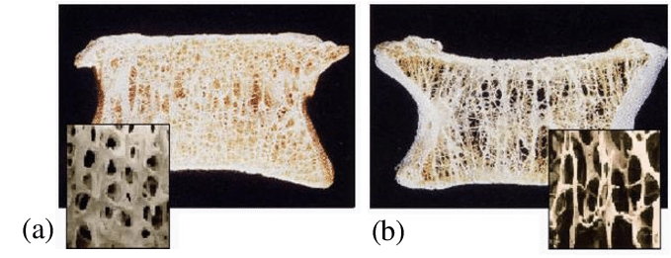
What is considered very high risk?
Recent fracture (within past 12 months)
Fractured while on osteoporosis therapy
Multiple fractures
Fractures while on drugs causing skeletal harm (glucocorticoids)
Very low T-score (less than -3.0)
High risk for falls or history of injurious falls
Very high probability by FRAX, > 30% MOF or > 4.5% hip
Camacho PM et al. AACE 2020 Clinical Practice Guidelines 2020 Update. Endocr Pract. 2020 May;26(Suppl 1):1-46.

Slide 28
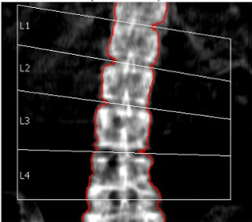
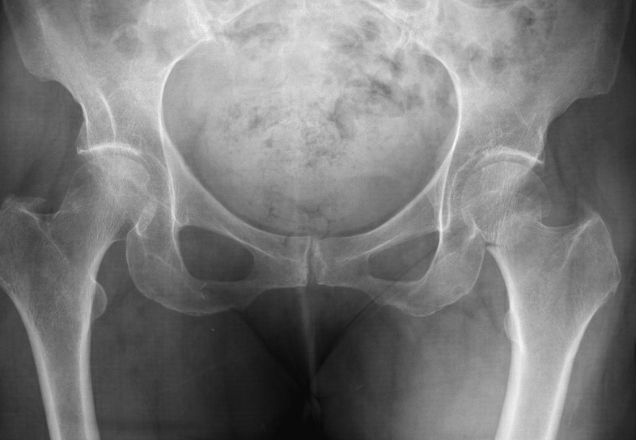
75 F fractured hip while on risedronate
Bone density still declining
2018: T-score -4.1 at L-spine, -2.0 at femoral neck
2021: T-score -4.4 at L-spine, -2.4 at femoral neck
Hip fracture in 2019 while on risedronate
Continued risedronate until 2021 (stopped for unknown reasons)
Notes:
4.4% decrease at the L-spine

Slide 29
What would you do at this point?
Resume risedronate/alendronate
Start denosumab
Start an anabolic agent – which one?
Teriparatide
Romosozumab

Slide 30
Options at this point
Patient’s function and motivation – able to do injections herself
Risk – very high risk, low spine T-score of -4.4, hip fracture
Reasonable options:
Start denosumab
Start anabolic agent (teriparatide or romosozumab)

Slide 31
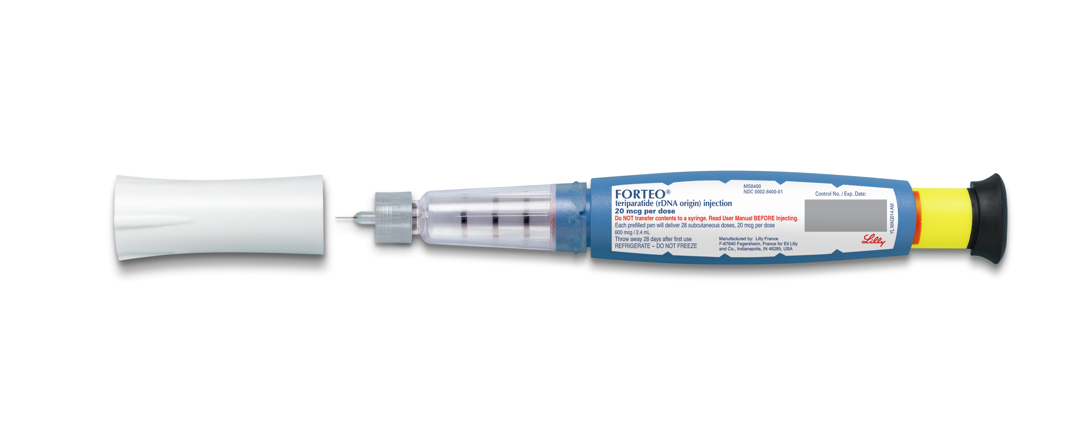
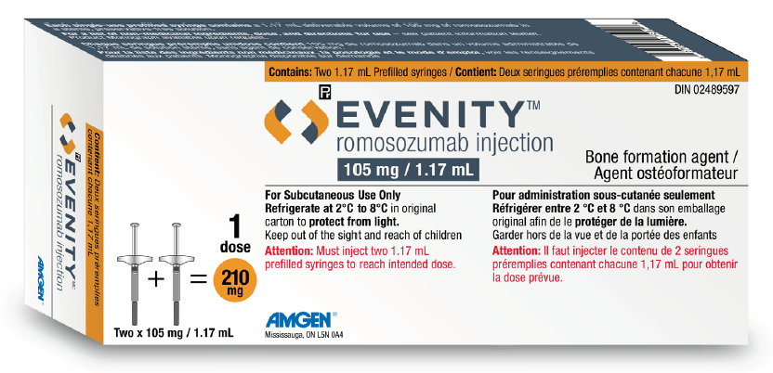
Anabolic agents
Teriparatide (Forteo)
Recombinant PTH
Daily SC injections x 2 years
Romosozumab (Evenity)
Anti sclerostin monoclonal antibody
Monthly SC injections x 12 months
Dual mechanism – bone forming and antiresorptive

Slide 32
Reasons to choose anabolic
More rapid gain in bone density (greater reduction in fracture risk)
Sequencing matters. Ideal to start with anabolic.¹
Romosozumab → denosumab +16.6%, +8.5% (L spine, total hip)
Denosumab → romosozumab +11.5%, +3.8%
1. McClung MR, Bolognese MA, Brown JP, Reginster JY, Langdahl BL, Shi Y, Timoshanko J, Libanati C, Chines A, Oates MK. Skeletal responses to romosozumab after 12 months of denosumab. JBMR Plus. 2021 Jun 3;5(7):e10512.
Notes:
Starting with romosozumab > denosumab is better than going in reverse order of denosumab to romosozumab.
Therapies that produce the greatest increase in BMD are associated with the greatest reductions in fracture risk.
ARCH trial showed that romosozumab was better than alendronate at reducing fracture risk.
Collectively, the results support starting with an anabolic agent followed by a potent antiresorptive agent as an optimal treatment sequence, particularly for women at very risk for fracture.

Slide 33
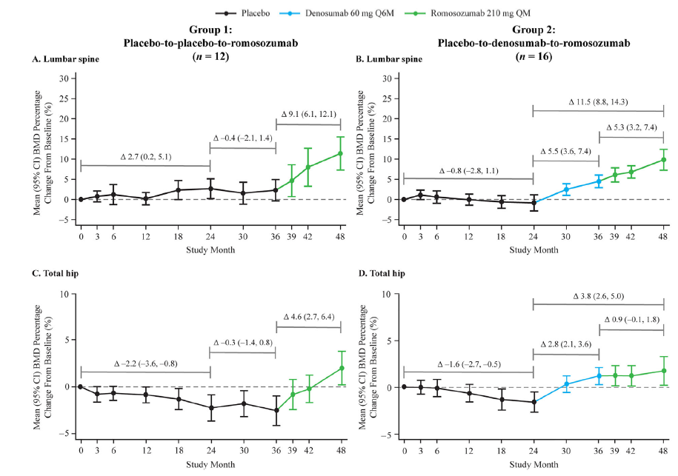
1. McClung MR, Bolognese MA, Brown JP, Reginster JY, Langdahl BL, Shi Y, Timoshanko J, Libanati C, Chines A, Oates MK. Skeletal responses to romosozumab after 12 months of denosumab. JBMR Plus. 2021 Jun 3;5(7):e10512.

Slide 35
End game – reduction in fractures
Superior fracture reduction compared to bisphosphonates
Teriparatide vs risedronate - VERO trial. HR 0.48 clinical fractures
Romosozumab vs alendronate – ARCH trial. 27% risk reduction clinical fractures
Superior fracture reduction romosozumab compared to denosumab

Slide 36
Teriparatide, Health Canada 2004
20 mcg SC daily x 2 years
Cost $1000 / month, apply through Customer Care Program
Contraindications
Hypercalcemia
Severe renal impairment
Hyperparathyroidism, Paget’s disease of the bone
Unexplained elevation of alk phos
Prior radiation involving the skeleton
Bone metastases or history of skeletal malignancy

Slide 37
Teriparatide
Side effects
Dizziness, nausea, arthralgia, asthenia, headache, leg cramps
Hypercalcemia, maximum 4-6 hours post-dose
Orthostatic hypotension, occasionally, and usually does not preclude continued treatment
Monitoring
Serum calcium
Repeat BMD before and after the 2 year course

Slide 38
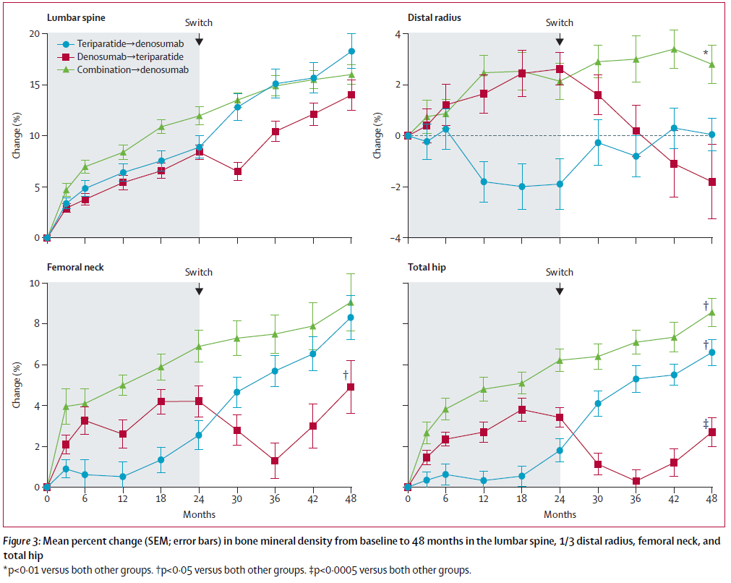
Teriparatide
Small caveat – for existing denosumab patients, combine therapy rather than switching to teriparatide.
Data-Switch study, Lancet 2015; 386: 1147-55

Slide 39
Romosozumab, Health Canada 2019
(2 syringes of 105 mg) 210 mg SC monthly x 12 months
Cost $7800 / year, apply through Patient Support Program
Contraindications
Hypocalcemia, hypersensitivity
Box warning
Avoid in patients with MI or stroke. Consider benefits/risks in patients with other cardiovascular risk factors

Slide 40
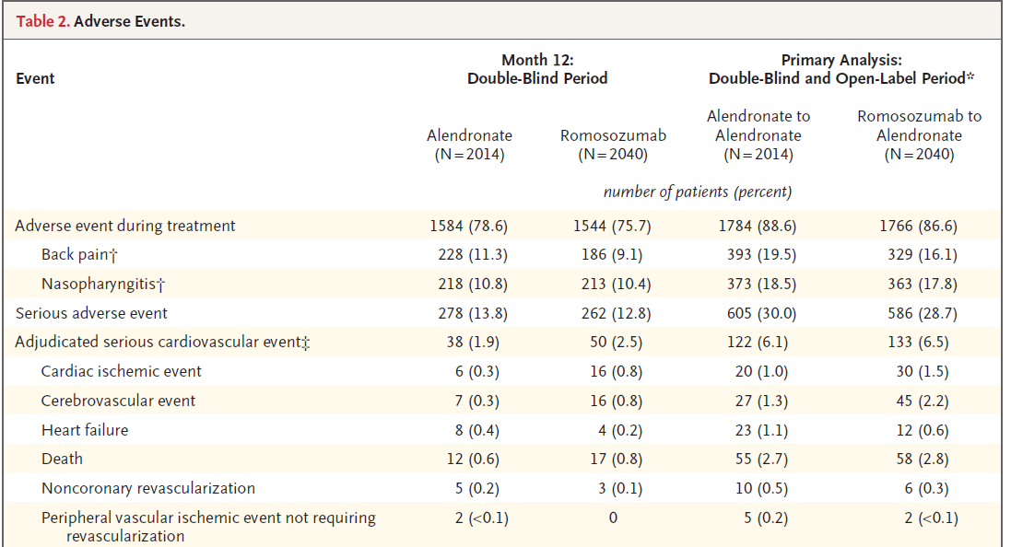
Romosozumab
Cardiovascular risk, only in comparator trial, but not seen in placebo control trial

Slide 41
Romosozumab
Side effects
Injection site reactions
Arthralgia
Headache
Hypocalcemia
Monitoring
Calcium, nadir occurred by 1 month in patients with normal renal function

Slide 42
Teriparatide or romosozumab?
Teriparatide | Romosozumab
Pros Long track record of safety (2004) | Pros Cheaper, $7800 per year Only once per month dosing x 1 year Better BMD gains than teriparatide (STRUCTURE trial)
Cons Daily SC injections x 2 years Price - $1000/month without coverage, could deter patients Avoid in patients with prior radiation therapy, bone cancer risk, unexplained high alk phos, hyperparathyroidism | Cons Avoid in MI/stroke or high risk CVD patients Shorter track record (HC approved 2019)

Slide 43
Follow-on therapy is required after anabolics
Transition to a potent antiresorptive agent to maintain the gains.

Slide 44
Take home points
Drug holidays only for bisphosphonates for low-moderate risk
Re-evaluate fracture risk at 5 years of oral bisphosphonate, 3 years of IV bisphosphonate. If high risk, can continue (or switch).
Consider anabolic agents (teriparatide or romosozumab) for very high risk patients, especially effective as up front therapy
Not hard to do. Apply through patient support programs for coverage and teaching.
Need to follow-on with antiresorptive agent to maintain gains

Slide 45
Questions?

